Slide 1
Satellite Imagery & AI for Prediction & Detection of Natural Disasters
Aman Raj - ENG21CT0003
Ankit Singh – ENG21CT0004
Md. Faizal – ENG21CT0026
Raja Sharma – ENG21CT0033

Slide 2
Introduction
Devastating Impact of Floods: Floods are one of the most destructive natural disasters, causing widespread damage to infrastructure, displacing communities, and leading to loss of life.
Technological Advancements for Flood Management: Recent advancements in satellite imagery and AI have significantly improved flood prediction, monitoring, and management capabilities.
Satellite Imagery and AI Revolutionize Flood Prediction: By analyzing satellite data, AI algorithms can accurately predict the occurrence and severity of floods, enabling timely warnings and evacuations.
Satellite Imagery and AI Enhance Flood Monitoring and Management: Real-time satellite imagery and AI-powered tools allow for efficient monitoring of flood-affected areas, facilitating effective response and recovery efforts.

Slide 3
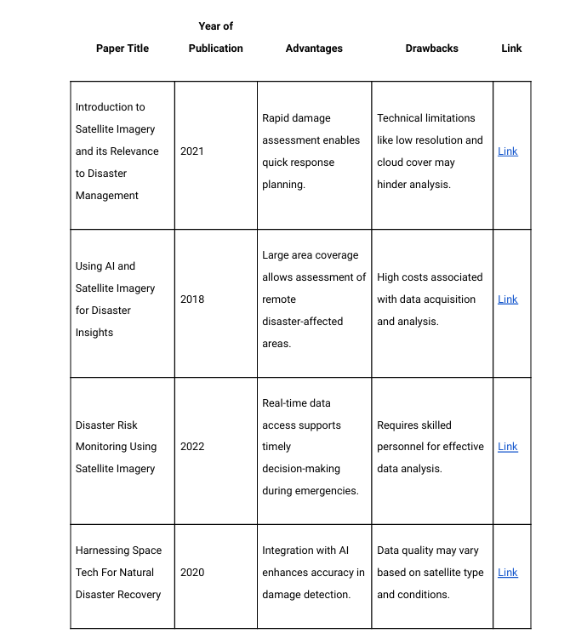
Literature Survey

Slide 4
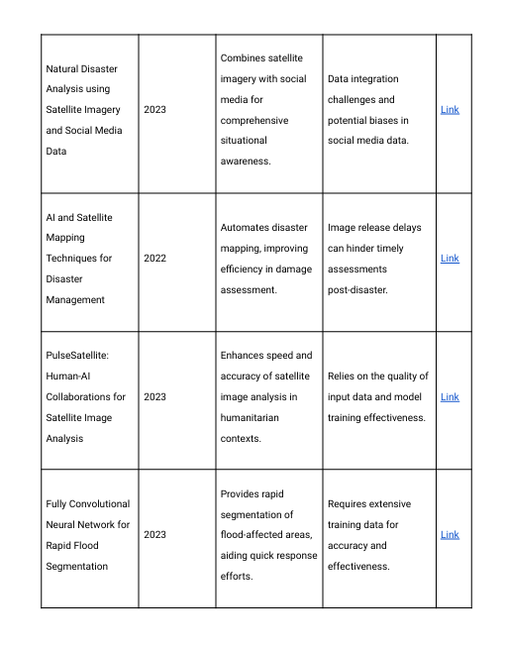
Literature Survey

Slide 5
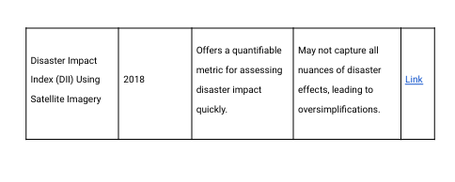
Literature Survey

Slide 6
Objective
Real-time Flood Monitoring
User-Friendly Tools
Predictive Flood Modelling
Accurate Damage Assessment
Track flood events using satellite data
Provide user-friendly tools for effective response.
Predict future floods
Assess flood damage with AI.

Slide 7
Methodology
Data Collection & Preprocessing
Source: Gather real-time and historical flood-related data, such as rainfall intensity, water levels, and weather patterns.
Preprocessing: Normalize data, handle missing values, and ensure data quality.Model Training
Architecture: Use deep learning models like Convolutional Neural Networks (CNN) for geospatial image analysis or Recurrent Neural Networks (RNN) for time-series data.Transfer
Learning: Implement pre-trained models such as VGG16 and fine-tune for flood-specific tasks.
Libraries: Leverage TensorFlow (model training), Pandas/NumPy (data handling), and Matplotlib (visualizations).
EvaluationMetrics: Assess accuracy, precision, recall, and F1-score.
Validation: Perform cross-validation for robustness.Integration
Open-Meteo Flood API: Use API to fetch real-time precipitation forecasts and hydrological data.
REST API: Connect the model with the backend for real-time predictions.DeploymentCloud Hosting: Deploy the model and API integrations for global accessibility.

Slide 8
Implementation
Step 3: Prepare the Dataset
Images: Organize the images in labeled folders (e.g., Flooded and Non-Flooded).
Weather Data: Ensure weather data is stored in a CSV file with features (e.g., temperature, rainfall) and a label column.
# Load image paths and labels
image_dir = "path_to_image_dataset"
categories = ["Flooded", "Non-Flooded"]
data = []
for category in categories:
path = os.path.join(image_dir, category)
label = categories.index(category)
for img in os.listdir(path):
img_path = os.path.join(path, img)
image = cv2.imread(img_path)
image = cv2.resize(image, (224, 224)) # MobileNet input size
data.append([image, label])
# Convert to numpy array
images, labels = zip(*data)
images = np.array(images) / 255.0 # Normalize images
labels = np.array(labels)
Combine Weather and Image Data (if necessary):
Load weather data and merge it with image labels.
Step 1: Set Up the Environment
Install the necessary libraries for your project. Use the following command:
pip install tensorflow keras numpy pandas scikit-learn matplotlib opencv-python
Step 2: Import Libraries
Start by importing the required Python libraries.
import tensorflow as tf
from tensorflow.keras.models import Model
from tensorflow.keras.applications import MobileNet
from tensorflow.keras.layers import Dense, GlobalAveragePooling2D, Dropout
from tensorflow.keras.preprocessing.image import ImageDataGenerator
from sklearn.model_selection import train_test_split
import numpy as np
import pandas as pd
import cv2
import os
import matplotlib.pyplot as plt

Slide 9
# Load weather data
weather_data = pd.read_csv("path_to_weather_data.csv")
X_weather = weather_data.drop(columns=["label"]).values
y_weather = weather_data["label"].values
# Optionally combine weather features with image features for advanced modeling
Split the dataset:
X_train, X_test, y_train, y_test = train_test_split(images, labels, test_size=0.2, random_state=42)
Step 4: Load and Fine-Tune MobileNet
Use a pretrained MobileNet model as the base and fine-tune it.
# Load MobileNet model without the top layers
base_model = MobileNet(weights='imagenet', include_top=False, input_shape=(224, 224, 3))
# Add custom layers on top
x = base_model.output
x = GlobalAveragePooling2D()(x)
x = Dense(128, activation='relu')(x)
x = Dropout(0.5)(x)
predictions = Dense(len(categories), activation='softmax')(x)
# Create the full model
model = Model(inputs=base_model.input, outputs=predictions)
# Freeze base layers
for layer in base_model.layers:
layer.trainable = False
Step 5: Compile and Train the Model
Compile the model:
model.compile(optimizer='adam', loss='sparse_categorical_crossentropy', metrics=['accuracy'])
Use data augmentation to improve generalization:
datagen = ImageDataGenerator(
rotation_range=20,
width_shift_range=0.2,
height_shift_range=0.2,
shear_range=0.2,
zoom_range=0.2,
horizontal_flip=True
)
datagen.fit(X_train)
Train the model:
python
Copy code
history = model.fit(datagen.flow(X_train, y_train, batch_size=32),
validation_data=(X_test, y_test),
epochs=10)

Slide 10
Step 6: Evaluate and Save the Model
Evaluate the model:
loss, accuracy = model.evaluate(X_test, y_test)
print(f"Test Accuracy: {accuracy}")
Save the model:
model.save("flood_detection_model.h5")
Step 7: Visualize Results
Plot the training and validation accuracy and loss.
plt.plot(history.history['accuracy'], label='Accuracy')
plt.plot(history.history['val_accuracy'], label='Validation Accuracy')
plt.xlabel('Epochs')
plt.ylabel('Accuracy')
plt.legend()
plt.show()
Step 8: Predict Flooding on New Data
Use the model for predictions on new images.
def predict_image(image_path, model):
image = cv2.imread(image_path)
image = cv2.resize(image, (224, 224)) / 255.0
image = np.expand_dims(image, axis=0)
prediction = model.predict(image)
return categories[np.argmax(prediction)]
result = predict_image("path_to_new_image.jpg", model)
print(f"Prediction: {result}")

Slide 11
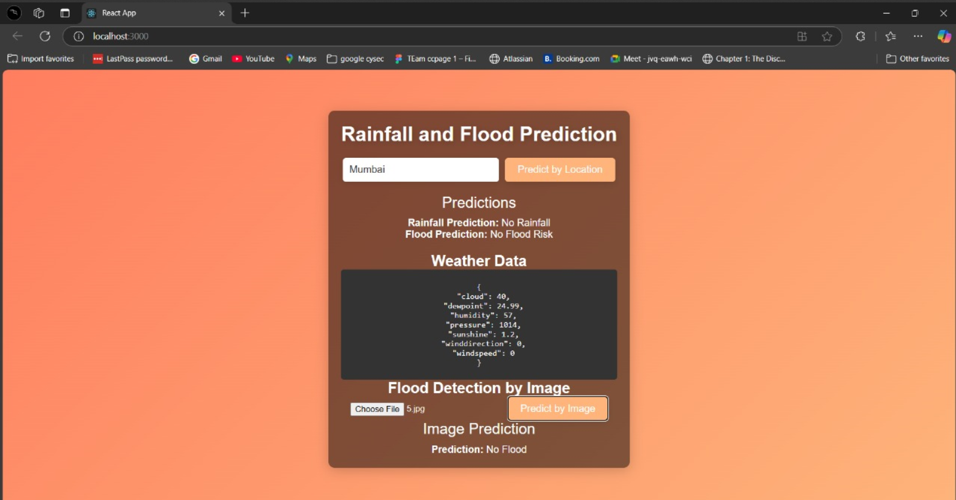
Output

Slide 12


